Slide 1


A Protocol for Python Schemas?
EuroPython 2019 Lightning Talk
12 July 2019
Martin Gfeller
martin.gfeller@swisscom.com
@mgf1610

Slide 2

Schemas
Schema: Description of data objects crossing program boundaries for validation (rejecting unforeseen data) and conversion to and from other formats.
Data Types / Type Hinting is for programs – Schemas are for data exchange.
Schema Library: A library supporting definition and application of Schemas, especially conversions.
Many solutions in the Python ecosystem: Lack of standards and interoperability:
Schema libraries differ in APIs and internal organization.
But all rely on some data types.
Integrated with Mapper | Standalone
Django | Cerberus
SQLAlchemy | Colander
Graphene for GraphQL | Flatland
Strawberry for GraphQL | KIM
 | Marshmallow
 | Schema
 | Valideer
 | Voluptuous
Notes:
DataTypes are for data in programs. Schemas are for data crossing boundaries – systems, UI

Slide 3
A Protocol for Schema Libraries
No standard API for creating Schemas or their elements, nor for internal structure.
But a minimal common protocol for interoperability:
Schema and Data:
Associate a Schema to an object
Validate data to conform to the schema
Convert data to/from an external representation
Identify some standard external representations
Schema handling
Enumerate elements of a Schema
Convert a Schema Element to a Python type, using PEP 593 Annotated types for additional information
Create a Schema Elements from a PEP 593 Annotated type created by this protocol
Provides a minimal “round trip” between different Schema Libraries
Notes:
We have a standard for DB API. 1996 – Python 1.4

Slide 4
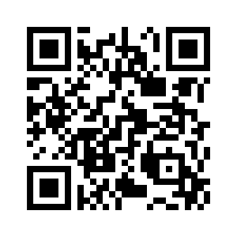
Interested? Get in touch!
Work in Progress: https://github.com/mcgfeller/py-schemas

